Slide 1
Cloudant NoSQL DB
Adrian M. perez
lbyclds

Slide 2

Access Cloudant
Cloudant API Wrappers
HTTP API / REST
Cloudant Web Console

Slide 3
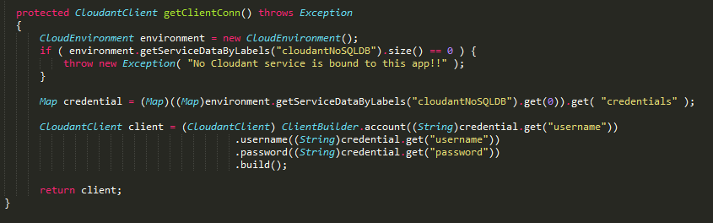
Connecting to the Service
Cloud Foundry API (org.cloudfoundry:cloudfoundry-runtime:0.8.4)
Cloudant API (com.cloudant:cloudant-client:2.3.0)

Slide 4
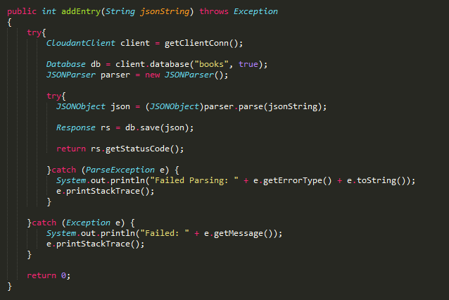
Add Entry

Slide 5
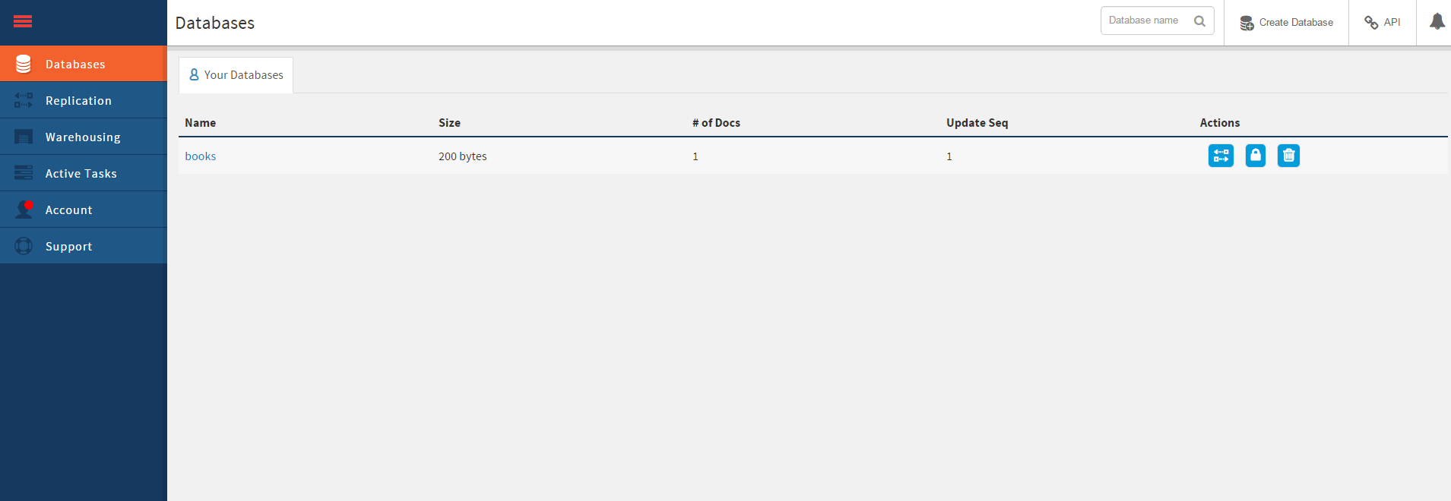
Cloudant Web Console

Slide 6
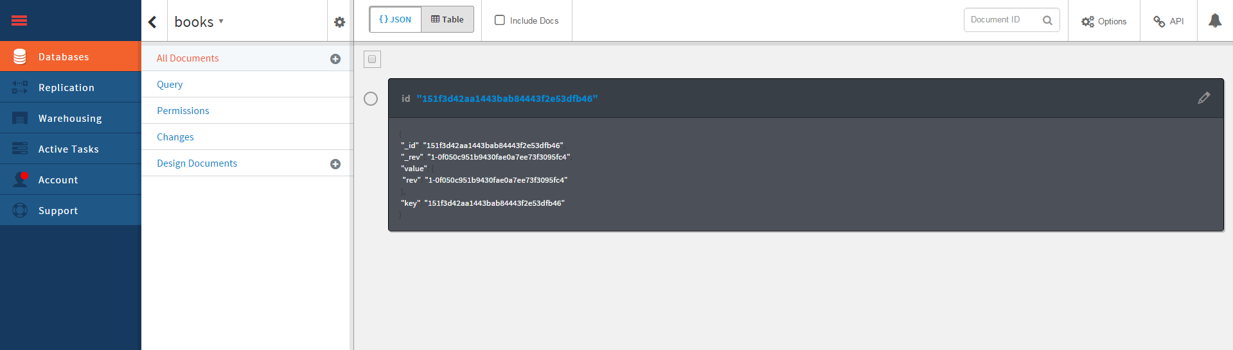

Slide 7
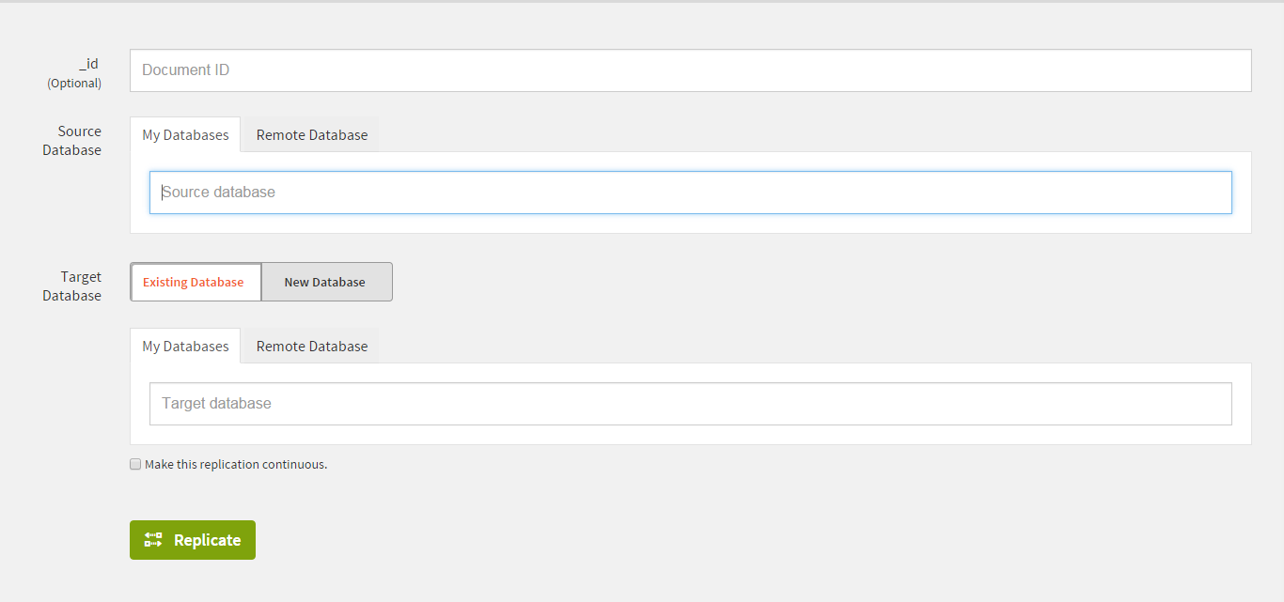
Replication

Slide 8
